Slide 1
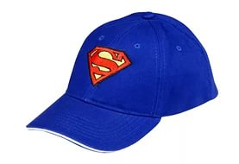
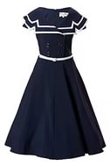
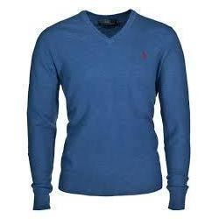
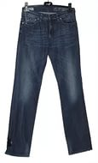
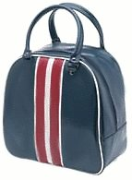
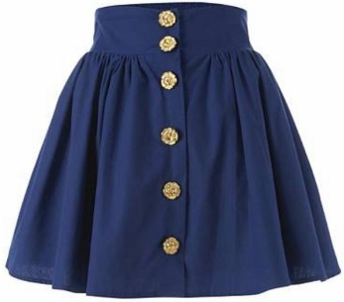
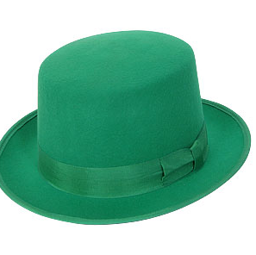
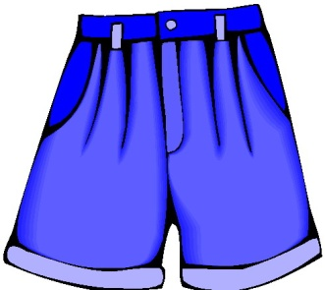
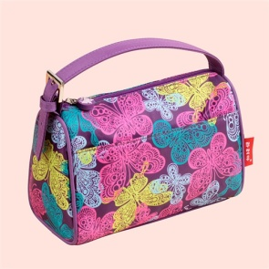
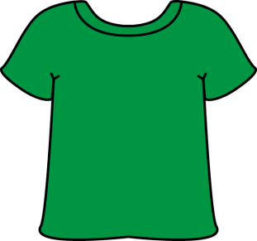
Checking up the homework.
Ex 4 A. P 133 Method “Identification”
Omar is going to wear Omar is going to take
Asel is going to wear Asel is going to take
Sasha is going to wear Sasha is going to take
Sara is going to wear Sara is going to take

Slide 2
Vocabulary
an artist- суретші a programmer- бағдарламашы a doctor - дәрігер a receptionist- қабылдаушы a lawyer - заңгер a pilot – ұшқыш a cosmonaut-ғарышкер a manager- басшы a banker- банкир a designer- дизайнер Noble – құрметті, атақты Illness – ауру, сырқат Wealth - байлық

Slide 3
The 4th of February I’ll be a doctor

Slide 4
Will+ Infinitive He will go to the U.K.
Future Infinitive болашақта жасалатын, бірақ алдын ала жоспарланбаған іс- әрекет туралы айтқанда қолданылады.
They will win the game.
Олар ойыннан жеңеді.
My mother will be sixty next week.
Менің анам келесі аптада алпыста болады

Slide 5
1. a person who drives a plane
2. a person who drives a car
3. a person who works and builds houses.
4. a person who teaches students.
5. a person who teaches pupils
6. a person who flies to the moon.
7. a person who studies at the Universities and Institutes
8. a person who learns to read and write at school.
9. a person who treats a patient
10. a person who dances

Slide 7
Letter.
Hello, my friends.
I am writing this letter from Astana. My name is Asel .
I am 13 years old. I study at Grammar school. I want to share with you my ideas concerning profession.
There are a lot of professions nowadays. But my dream is to become a doctor. Doctor is a noble and an important profession. When I’m twenty five, I’ll be happy when people of my country are healthy and wealthy. As they say “ Health is above wealth”. What about you, my friends? What will you be when you are twenty five Love, Asel.

Slide 8
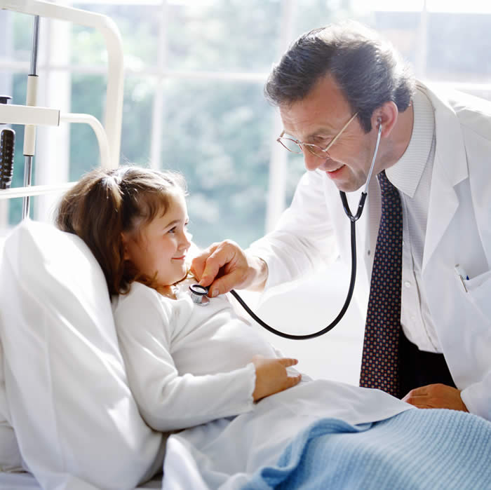
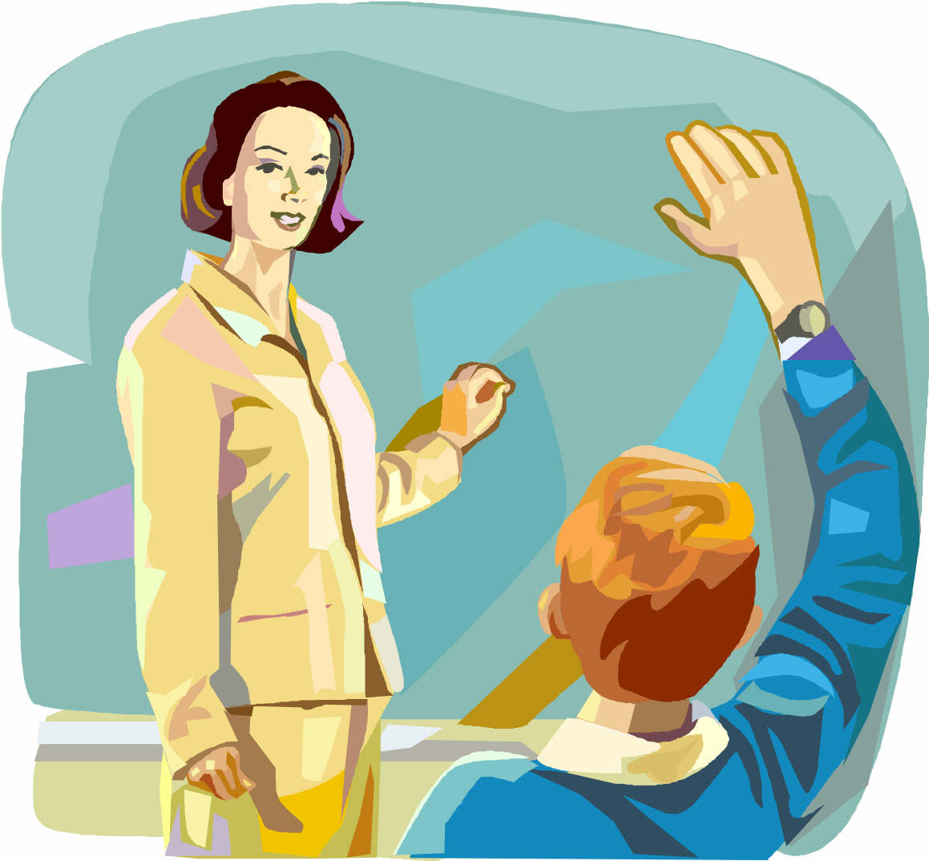
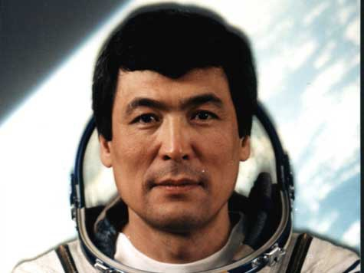
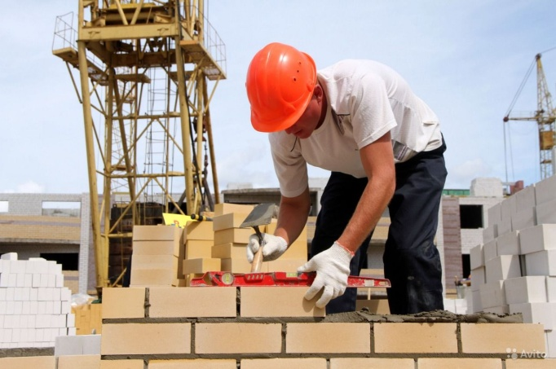
We’ll be a doctor We’ll be a teacher
We’ll be a pilot We’ll be builder
Phonetic drill

Slide 9
“If I will be a ….”
1.If I will be a doctor
I’ll always treat the patient
I’ll treat them every where
2.If I will be a teacher
I’ll always give them knowledge
I’ll teach them every day.
3.There are so many trades
Choose anyone you like
Choose anyone you like.

Slide 10
Translate the following sentences
1.Менің атым Джейн.
2.Мен сіздермен мамандық жөнінде –өз ойымды бөліскім келеді.
3.Менің арманым дәрігер болу.
4.Дәрігер құрметті де , маңызды мамандық.
5.Мен науқастарды емдеймін және сырқаттарынан айығуға көмектесемін.
6.Елімнің халқы бай әрі дені сау болса мен бақытты боламын .
7. Жиырма бес жаста болғанда сен кім болғың келеді?

Slide 11
Homework.
Write an essay “I’ll be a …”

Slide 12
Method “Moon”
- full moon I understand | -half moon I understood half | - new moon I don't understand many tasks

